Slide 1
STM32 Basic
Training Course
HCM - 2021

Slide 2
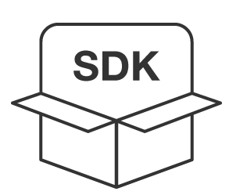

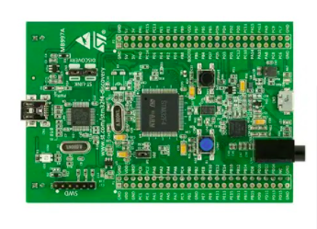
+

Slide 3

INSTRUCTOR
TRƯƠNG NGỌC PHÚ (1991)
Embedded System Specialist
Experience 8+ years Embedded Hardware & Software
Have worked for: Tekbox, Renesas, BanVien MimosaTEK
Expertise:
  Embedded Hardware & Software
  STM32 MPU, STM32 MCU
  NXP, TI MCU
  Embedded Linux
  M2M & IoT system
  Hardware Security
Own Business: Smart Device & IoT Development
http://kienminh.net/

Slide 4
Agenda
Embedded System Overview
Embedded C
Keil-C Simulator
Sample Project

Slide 5
Training material - Github
https://github.com/kmtekvn/hitech_stm32_basic
Git management tool
https://desktop.github.com/
Software
https://1drv.ms/u/s!AjRP3z7340A0xy4qGKA6xQHUkSGl?e=mhSbex

Slide 6
Embedded Overview

Slide 7

Embedded System

Slide 8
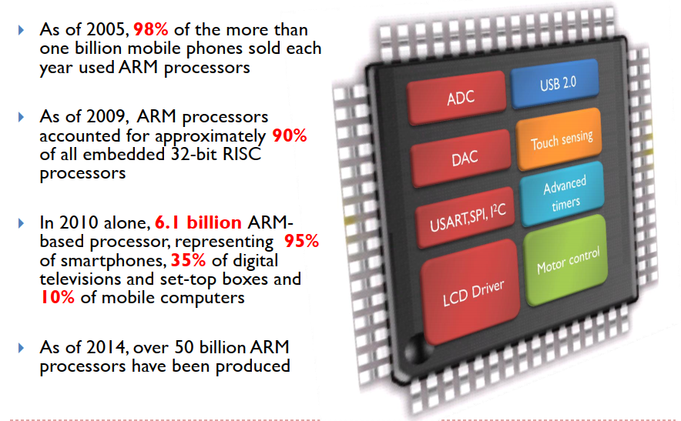
Why ARM Processor

Slide 9
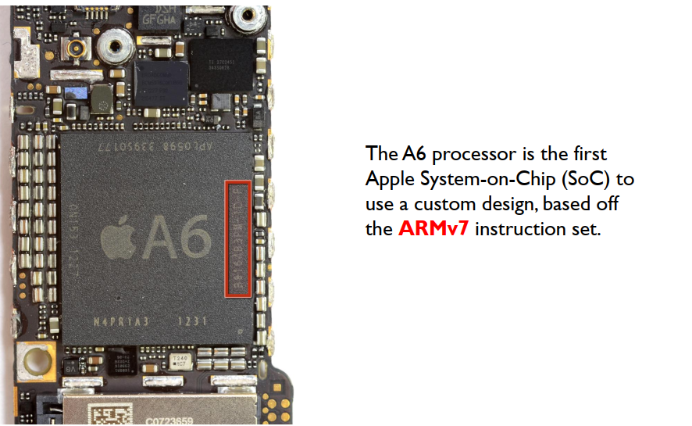

iPhone 5 Teardown

Slide 10
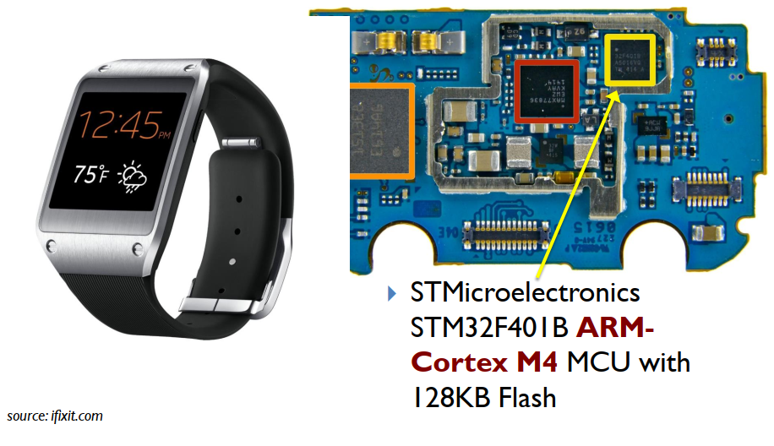
Samsung Galaxy Gear

Slide 11
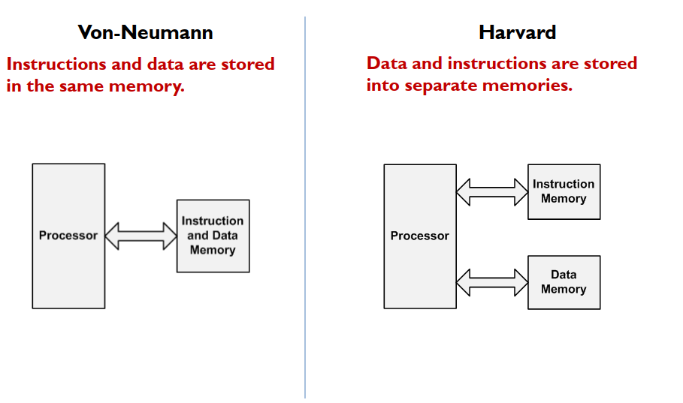
Computer Architecture

Slide 12
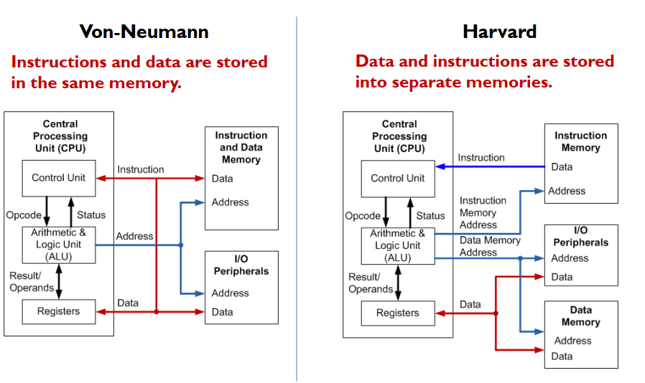
Computer Architecture

Slide 13
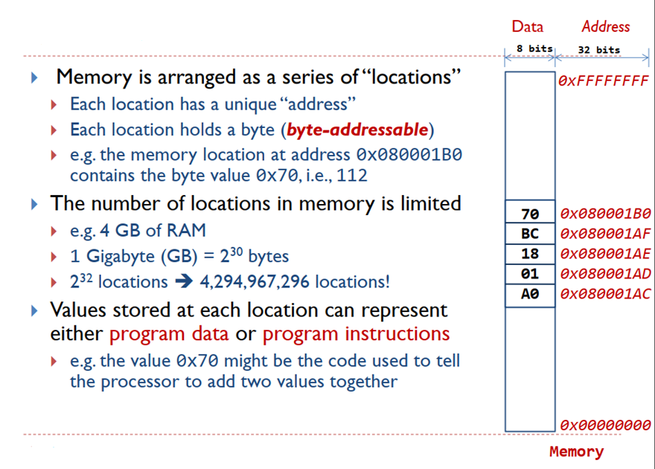
Memory

Slide 14
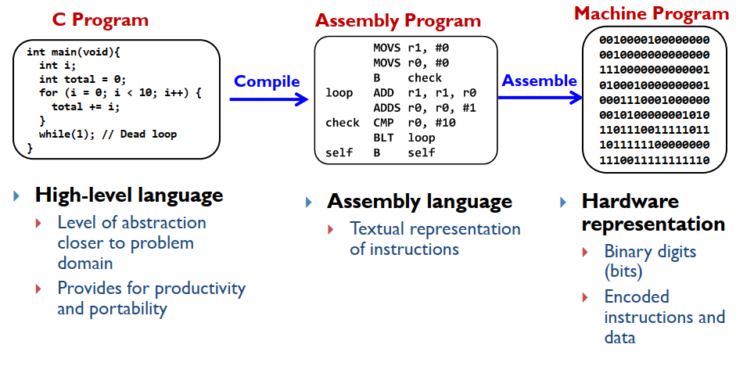
Levels of Program Code

Slide 15
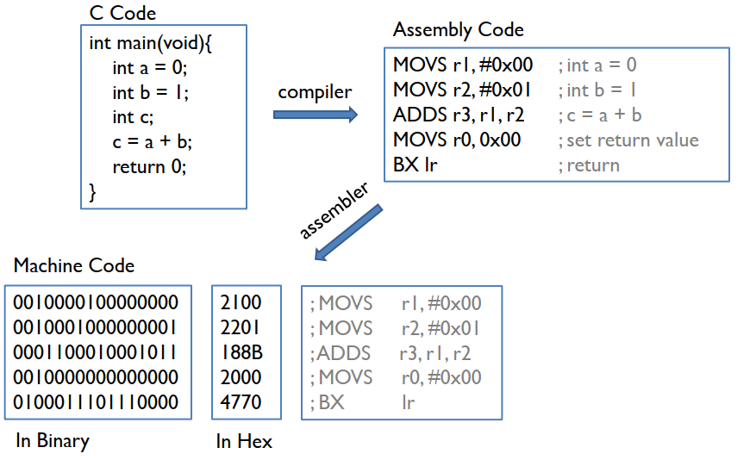
See a Program Runs

Slide 16
Embedded C

Slide 17
Logical and Bitwise Operators

Slide 18
Logical Operators
A logical operator is used to combine 2 or more conditions in an expression.
Logical AND - &&
  Operator && returns true when both the conditions in consideration are true; else false
Logical OR - ||
  Operator || returns true when either or both the conditions in consideration are true; else false
Logical NOT - !
  Operator ! returns true when either or both the conditions in consideration are true; else false
Logical XOR
  In the Boolean sense, this is just != (not equal)

Slide 19
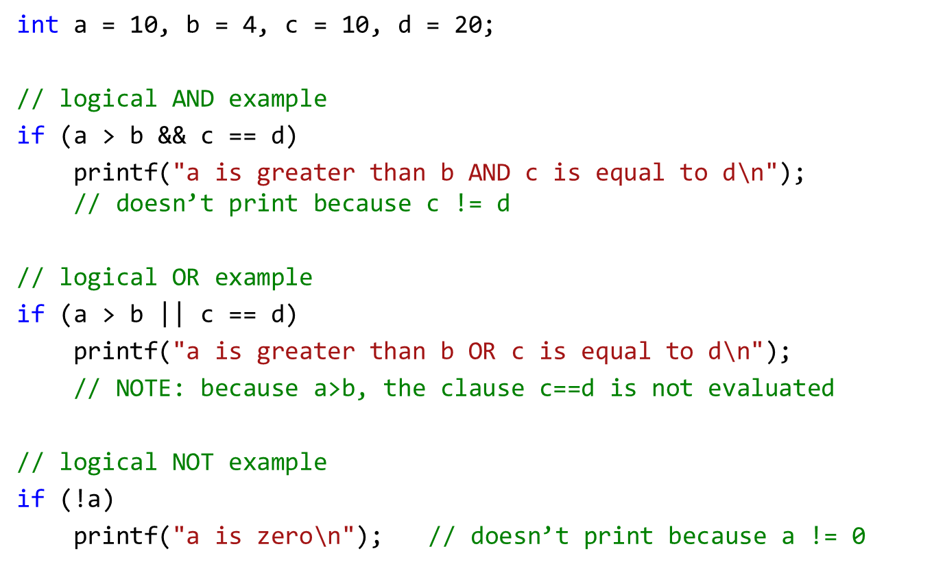
Logical example

Slide 20
C Bitwise Operators
C has 6 operators for performing bitwise operations on integers
Operator | Meaning
& | Bitwise AND | Result is 1 if both bits are 1
| | Bitwise OR | Result is 1 if either bit is 1
^ | Bitwise XOR | Result is 1 if both bits are different
>> | Right shift
<< | Left shift
~ | Ones complement | The logical invert, same as NOT

Slide 21
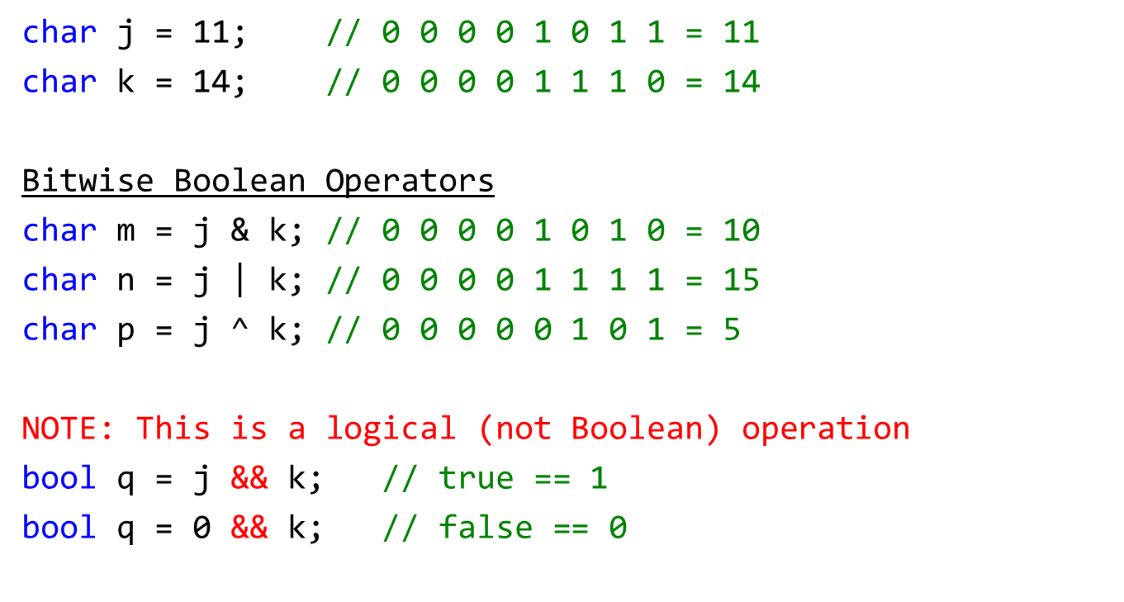
Bitwise Boolean examples

Slide 22
Shifting and Inversion

Slide 23
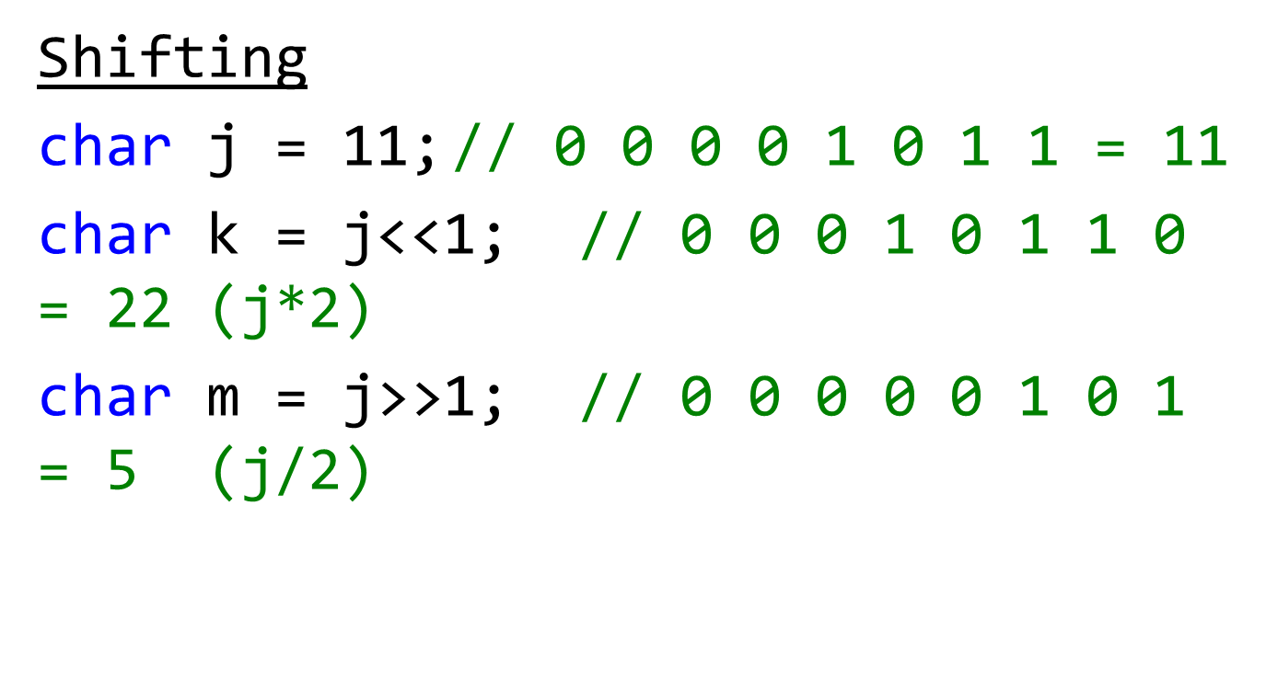
Shifting

Slide 24
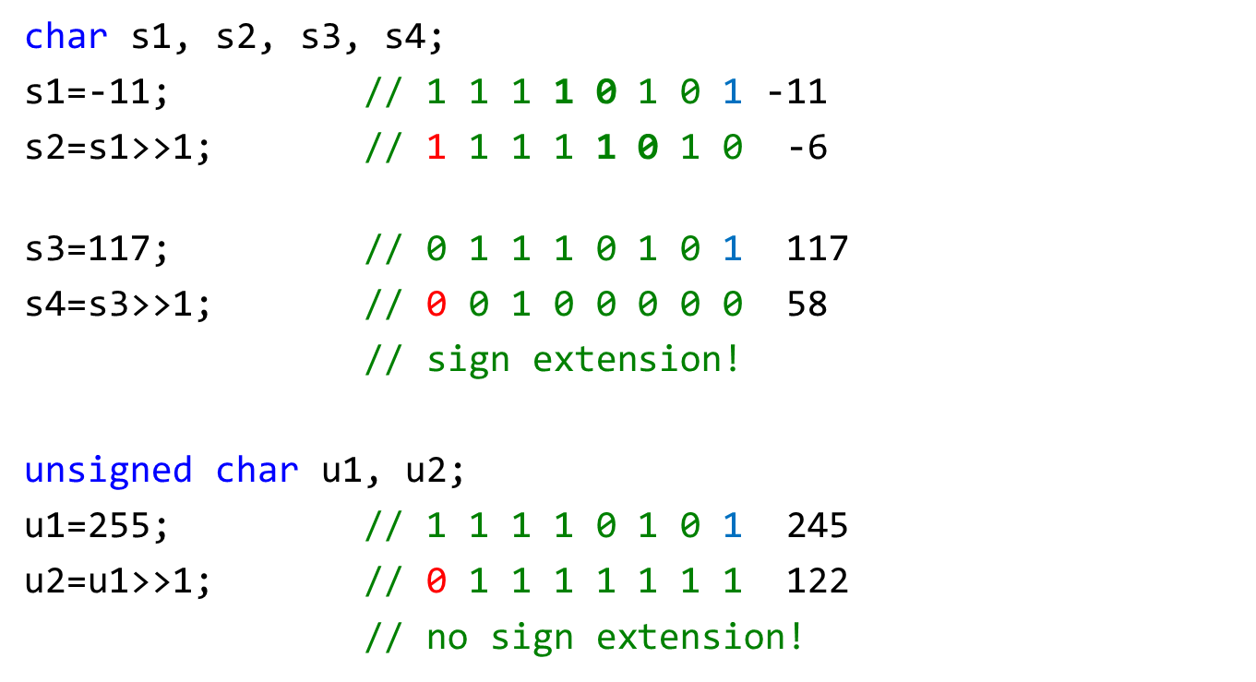
Shifting

Slide 25
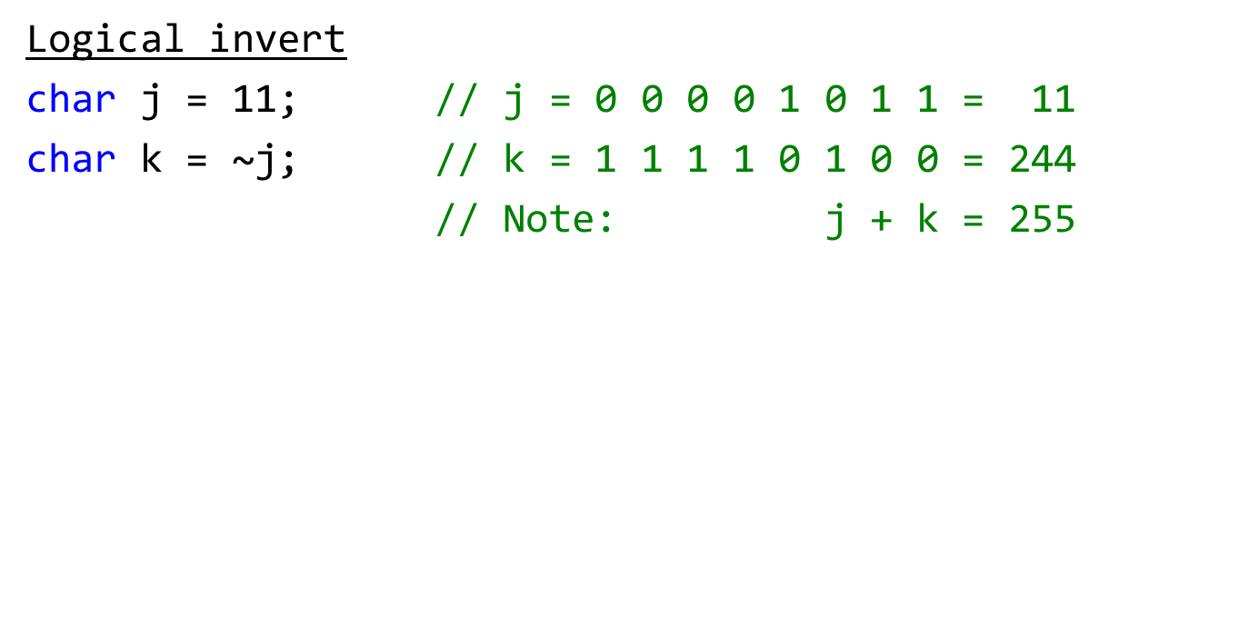
Inversion

Slide 26
Arrays and pointers

Slide 27
Array Identifiers & Pointers
char message_array[] = “Hello” ;
Question: So what exactly is message?
Answer: In C, an array name is a constant pointer that references the 0th element of the array's storage.
Constant means it cannot be changed (just as we can't change the constant 3).

Slide 28
Consequences
char message_array[] = “Hello” ;
char *message = “Hello”;
Question: What is *message?
*message == ‘H’; // an array pointer. It points to the
// start of the array (to 0th element)
Read *message as “what message points to”
What is another expression for message?
message == &message[0]; message[0]==‘H’

Slide 29
Pointer Variables and Arrays
char *hi = “Hello” ;
Allocates space and initializes a constant string “Hello”, then
allocates space for pointer hi and initializes it to point to the 0th element.
char message[] = “Greetings!” ;
Allocates space for the array message and initializes its contents to the string “Greetings!”.
char *p_mesg = message ;
Allocates space for pointer p_mesg and initializes it to point to message.
char ch ; // Declares ch as a char
p_mesg++ ; // Advance p_mesg by one element (char in this case)
ch = *p_mesg ; // Set ch to the character p_mesg points to (in this case 'r').

Slide 30
C Structures

Slide 31
C Structs
A struct is a way of grouping named, heterogeneous data elements that represent a coherent concept.

Slide 32
C Structs
A struct is a way of grouping named, heterogeneous data elements that represent a coherent concept.
Example:
  #define MAXNAME (20)
  struct person {
  char name[MAXNAME+1] ;
  int age ;
  double income ;
  } ;

Slide 33
C Structs
Question: What is an object with no methods and only instance variables public?
Answer: A struct! (well, sort of).
A struct is a way of grouping named, heterogeneous data elements that represent a coherent concept.
Example:
  #define MAXNAME (20)
  struct person {
  int age ;
  double income ;
  } ;
coherent concept -
the information recorded for a person.

Slide 34
C Structs
Question: What is an object with no methods and only instance variables public?
Answer: A struct! (well, sort of).
A struct is a way of grouping named, heterogeneous data elements that represent a coherent concept.
Example:
  #define MAXNAME (20)
  struct person {
  char name[MAXNAME+1];
  int age ;
  double income ;
  } ;

Slide 35
Using Structs
Declaration:
  struct person {
  char name[MAXNAME+1] ; // explicit size known
  char *title; // a pointer has explicit size
  char profession[]; // ILLEGAL, size not known
  int age ;
  double income ;
  } ;
Definitions:
  struct person mike, pete, chris ;
Assignment / field references ('dot' notation):
  mike = pete ; // this does a shallow copy!!
  // If the structure contains pointers, the pointers will be
  // copied, but not what they point to. Thus, after the copy,
  // there will be two pointers pointing to the same memory.
  pete.age = chris.age + 3;

Slide 36
Using Structs
Note: Space allocated for the whole struct at definition.
Struct arguments are passed by value (i.e., copying)
WRONG
void give_raise( struct person p, double pct) {
p.income *= (1 + pct/100) ;
return ;
}
give_raise(mike, 10.0); // what is mike’s income after raise
RIGHT
struct person give_raise(struct person p, double pct) {
p.income *= (1 + pct/100) ;
return p ;
}
mike = give_raise(mike, 10.0) ; // what is mike’s income after raise?

Slide 37
Using Structs pointers
Better if you can pass a pointer to the structure
void give_raise(struct person *p, double pct) {
p->income *= (1 + pct/100) ;
return ;
}
give_raise(&mike, 10.0) ;

Slide 38
Const qualifier

Slide 39
Const qualifier
The const qualifier applied to a declared variable states the value cannot be modified.
Using this feature can help prevent coding errors.
Good for settings and configurations.
const char * - a pointer to a const char
the value being pointed to can't be changed but the pointer can.
char * const - is a constant pointer to a char
the value can be changed, but the pointer can‘t
Order can be confusing…

Slide 40
Const qualifier cont.
To avoid confusion, always append the const qualifier.
int * mutable_pointer_to_mutable_int;
int const * mutable_pointer_to_constant_int;
int * const constant_pointer_to_mutable_int;
int const * const constant_ptr_to_constant_int;

Slide 41
Symbolic Names
typedef

Slide 42
Symbolic Type Names - typedef
Suppose we have a pricing system that prices goods by weight.
  Weight is in pounds, and is a double precision number.
  Price is in dollars, and is a double precision number.
  Goal: Clearly distinguish weight variables from price variables.

Slide 43
Symbolic Type Names - typedef
Suppose we have a pricing system that prices goods by weight.
  Weight is in pounds, and is a double precision number.
  Price is in dollars, and is a double precision number.
  Goal: Clearly distinguish weight variables from price variables.
Typedef to the rescue:
  typedef declaration ;
  Creates a new "type" with the variable slot in the declaration.

Slide 44
Symbolic Type Names - typedef
Suppose we have a pricing system that prices goods by weight.
  Weight is in pounds, and is a double precision number.
  Price is in dollars, and is a double precision number.
  Goal: Clearly distinguish weight variables from price variables.
Typedef to the rescue:
  typedef declaration ;Creates a new "type" with the variable slot in the declaration.
  Examples:
  typedef double PRICE_t; // alias for double to declare price variables
  typedef double WEIGHT_t; // alias for double to declare weight variables
  PRICE_t p ; // double precision value that's a price
  WEIGHT_t lbs ; // double precision value that's a weight

Slide 45
typedef In Practice
Symbolic names for array types
  #define MAXSTR (100)
  typedef char LONG_STRING_t[MAXSTR+1] ;
  LONG_STRING_t line ;
  LONG_STRING_t buffer ;
  LONG_STRING_t *p_long_string;

Slide 46
typedef In Practice
Symbolic names for array types
  #define MAXSTR (100)
  Typedef char LONG_STRING_t [MAXSTR+1] ;
  LONG_STRING_t line ;
  LONG_STRING_t long_string;
Shorter name for struct types:
  typedef struct {
  LONG_STRING_t label ; // name for the point (fixed length)
  double x ; // x-coordinate
  double y ; // y-coordinate
  } POINT_t;
  POINT_t origin ;
  POINT_t focus ;
  POINT_t *p_point = origin;

Slide 47
Keil-C Simulator

Slide 48
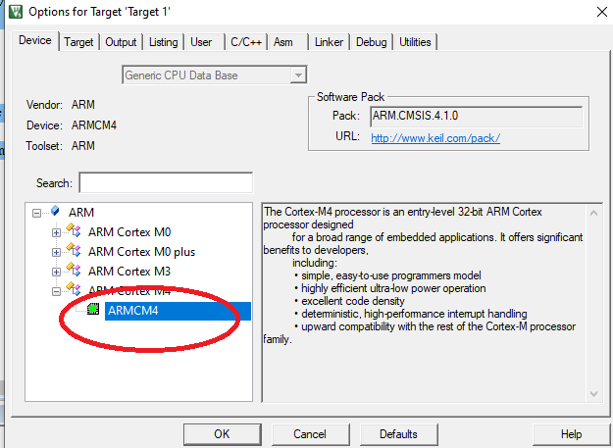
Create Project

Slide 49
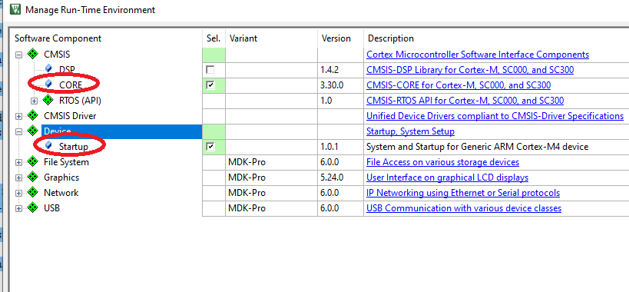
Manage Run-Time Env

Slide 50
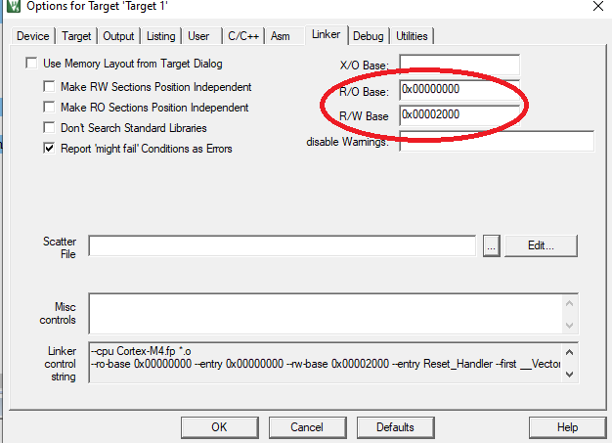
Change Linker Option

Slide 51
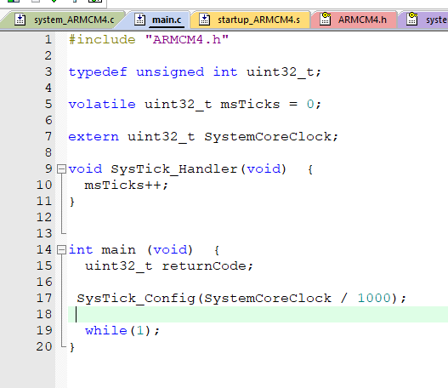
Example code - SysTick

Slide 52
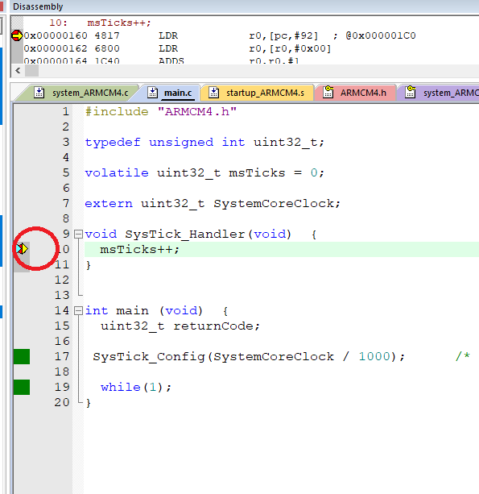
Keil-C – Set Breaking Point

Slide 53
Question Time

